Slide 1

Create Ansible content more efficiently by leveraging artificial intelligence
Frédéric Wautelet
University of Namur

Slide 2
Ansible LightSpeed
What is Ansible?
Origin and Creator
Created by Michael DeHaan in 2012.
Acquired by RedHat in 2015 and later by IBM in 2018.
Versatility in HPC Clusters
Can be used to set up Linux or Windows workstations.
Can be used to configure identical user environments on several HPC clusters.
Simplicity and Efficiency
Simple and user-friendly interface.
It excels in managing various IT resources, including servers, networks, users, software, and security settings.
Idempotence
Ansible's modules are idempotent, ensuring consistent results even with multiple executions.
Agentless & SSH-Based
No need to install an agent on managed resources.
Requires only SSH connection and minimal Python installation.
Beyond Configuration Management
Ansible has now evolved to handle DevOps tasks.
Automate Continuous Integration (CI), Continuous Deployment (CD), and provisioning processes.
Notes:
Ansible is a free and open-source configuration management and software automation project developed by Red Hat. It is mostly used in production environments such as in servers for setting them up.

Slide 3
Ansible installation
pip3 install ansible --user
Ansible LightSpeed
Debian based distro
$ sudo apt update
$ sudo apt -y upgrade
$ sudo apt install -y build-essential libssl-dev libffi-dev python3-dev python3-pip
$ pip3 install ansible --user
RedHat based distro
$ sudo yum install epel-release
$ sudo yum install python3-pip
$ sudo pip3 install -U pip –upgrade
$ pip3 install ansible --user
Only available on Linux or MacOS.
Installation in user space or using Virtualenv.

Slide 4
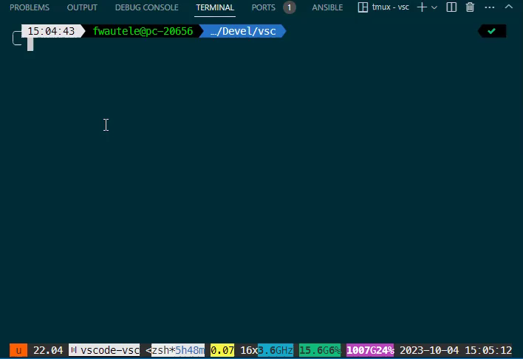
Custom installation
Ansible LightSpeed
If you need a specific version or if you need to install multiple Ansible versions.
In a Python virtualenv.
Using pip.
Steps to install:
Create Python virtualenv
Install Ansible using pip
Check version
Exit virtualenv
Activate the virtualenv to use Ansible.

Slide 5
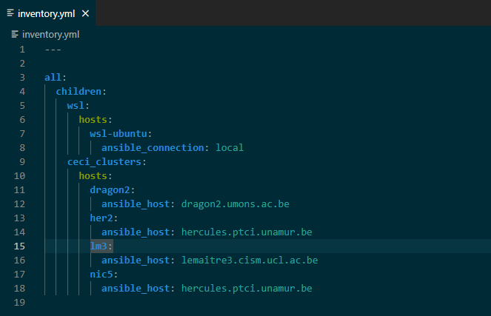
Ansible Inventory
Ansible LightSpeed
List of managed hosts that Ansible configures.
Hosts can be grouped.
Use client ssh config.
Useful for ProxyJump.
Possibility of more complex setup.
Hosts in multiple groups.
parent/child relationships among groups.
Ranges of hosts.
And more…
Notes:
Possibility to configure ssh options such like proxyjump in ansible but to reamis portable,
ProxyJump should be configured in ssh config

Slide 6
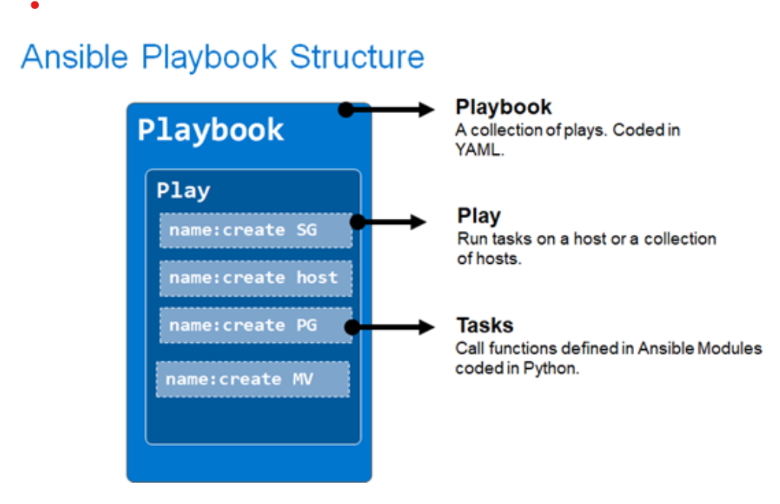
Anatomy of an Ansible playbook
Ansible LightSpeed
Playbooks are written in YAML format.
Structure: playbook – plays – tasks.
Play: Contains a list of tasks to be performed on the hosts.
Hosts: Specifies the target hosts or groups where tasks will be executed.
Tasks: he smallest unit of action you can automate. Use Ansible Modules.
Ansible modules are predefined scripts for specific tasks like file manipulation, package installation, or service management.

Slide 7
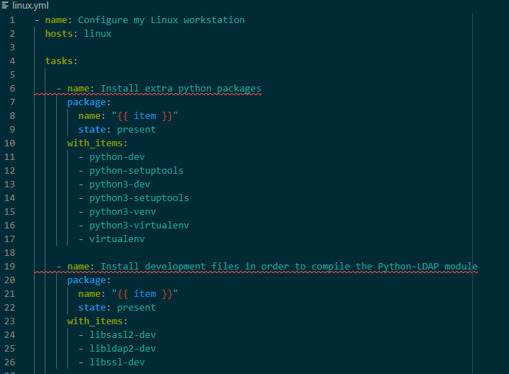
My first Ansible play
Ansible LightSpeed
Install several Python libraries on my workstation.
If I re-run this play, nothing will be changed.

Slide 8
What is Ansible Lighspeed?
Ansible LightSpeed
VSCODE extension.
Use natural language processing.
Reads task description in plain English.
Generate Ansible code.
Require a GitHub account.

Slide 9
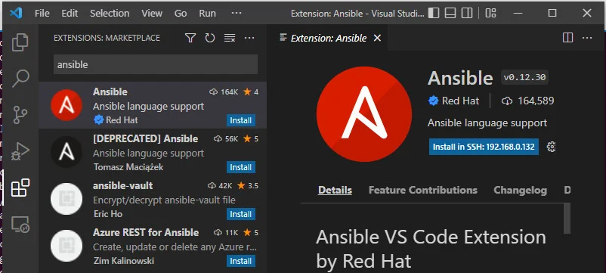
Step 1: install VS Code extension
Ansible LightSpeed
Search Ansible on the marketplace.
Install the official extension by Red Hat.

Slide 10

Step 3: Connect VS Code with Lightspeed.
Ansible LightSpeed
Navigate to the Ansible icon on the left-hand side, then click Connect.
Log in using your GitHub account and authorize to give it permission.

Slide 11
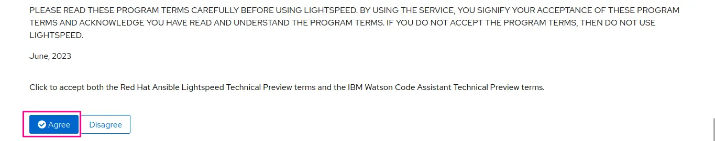
Step 3: Connect VS Code with Lightspeed.
Ansible LightSpeed
Navigate to the Ansible icon on the left-hand side, then click Connect.
Log in using your GitHub account and authorize to give it permission.
Read the program terms, then accept it.

Slide 12

Step 3: Connect VS Code with Lightspeed
Ansible LightSpeed
Navigate to the Ansible icon on the left-hand side, then click Connect.
Log in using your GitHub account and authorize to give it permission.
Read the program terms, then accept it.
We will be directed to VS Code by clicking Authorize.

Slide 13
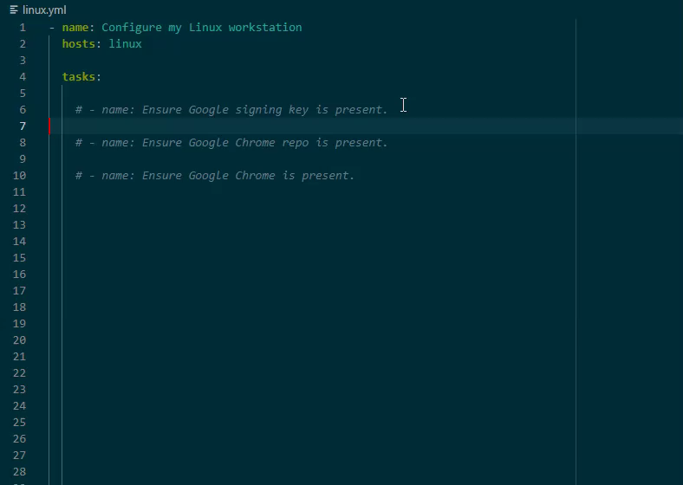
Let’s generate!
Ansible LightSpeed
Create a YAML file.
Define the task only by describing it in the name section.
Put your cursor at the end of the task description, then press Enter.
Wait for Lightspeed to generate and a preview of the suggestion will appear.
Press TAB if you’re fine with the generated task and turn it into active text.

Slide 14

Ansible LightSpeed
Conclusions
Other AI tools that are not specifically designed to generate Ansible code struggle to generate code that respects Ansible best practices.
As users continue to use Ansible Lightspeed, model recommendations will continually improve based on the additional data available for artificial intelligence models.
The tool is promising and offers a significant productivity boost.
Ansible Lightspeed is still available free of charge to all Ansible users.
Notes:
unlike github copilot, Ansible LightSpeed is free.

